Slide 1
Enhancing PCL Usability: A GUI Front-End, Interfacing with VTK, Image Processing on Point Clouds, and More!
David Doria

Slide 2
GSoC Projects
Object Reconstruction
Web-based applications
Recognition module improvements
New feature descriptors
Segmentation Algorithms
Real-time 3D Applications (Kinect)
GPU Particle Filters
3D edge extraction
2D Image Drawing
Graphical Model-based Segmentation

Slide 3
Overview Of This Talk
2D Image Processing (Nikhil Somani)
Lightweight GUI Front-end (Jeremie Papon)
PCL in PowerPoint (P. Kalogiros G. Popa)
PCL/VTK Conversions (R. Rusu, D. Doria)
PCL Examples Initiative

Slide 4
2D Image Processing (Nikhil Somani)
Apply image processing techniques to point cloud data (color and depth)
No library dependencies
Simple data-types (can be plucked out of PCL and used in other applications with ease!)

Slide 5
Example
Canny edge
Gray threshold
+
Gray dilation

Slide 6
Follow-up with 3D Processing

Slide 7
2D Image Features
Filtering with custom kernels (convolution)
Edge detection (Canny, Sobel, Roberts, Prewitt, Laplacian of Gaussian, SUSAN)
Morphological operators (grayscale and binary opening, closing, erosion, dilation)
2D keypoint extractors and feature descriptors(Harris corner, Harris-Affine, Hessian, blob, SIFT, SURF, HoG, Signatures, MSER)

Slide 8
Edge Detection
Canny
Roberts
Prewitt
Sobel

Slide 9
Morphological Operations
erosion
dilation
opening
closing

Slide 10
Keypoint Detection
(Harris Corners)

Slide 11
More Features Coming Soon!
Image Transformations
Euclidean, Similarity, Affine, Projective
Segmentation using Graph Cuts :
Binary segmentation using min-cut/max-flow.
Multi-label optimization using α-expansion and α-β-swap algorithms

Slide 12
A GUI for PCL
Graphical interface for manipulating clouds
Allows new users to easily experiment with PCL capabilities
Extensible – plug-in architecture easy to extend as PCL evolves
Multiplatform – Qt/VTK
Model/View architecture -> flexibility

Slide 13
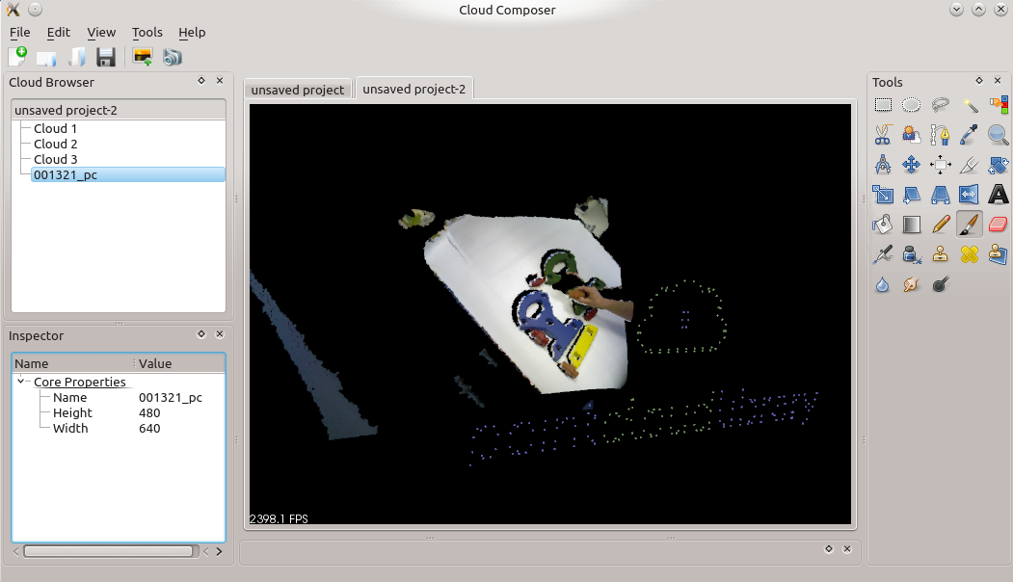
Preview
Project Browser
PCL Tools/ Plugins
Cloud Viewer
Project Model
Property
Inspector &
Editor
Cloud
Cloud
Cloud
Normals
Normals
Normals
FPFH
NARF
SHOT

Slide 14
Plugin System
Tool Plugin
Tool Selector
Cloud Composer Project Model
Tool Factory
Tool Parameter Model
Cloud₀
Cloud₂
Undo/Redo Stack
Tool Parameter View
Cloud₁
Cloud
Modify
Work Queue
Cloud
Merge
Worker Thread (s)
Cloud Command
Cloud Command
Cloud
Cloud
Split
Tool Instance
Cloud
Working Copy
Tool Instance
Tool Instance
Cloud
Create
Cloud
Initial State
Notes:
PCL functionality encapsulated within a set of plugin tools
Separate the GUI Model and Views from the workers
Uses Qt plugin framework (multiplatform)
Tool factory generates tool instance
Generates cloud command instance from pre-defined command types
Pushes this onto work queue
Plugins never touch model directly – they work on local copies of data through commands (which are defined in GUI code)
Once tool completes, output replaces original cloud(s) in the model, with original(s) pushed onto undo stack
Work queue spawns worker threads and moves tool instances to them
Pops commands off queue until data dependency occurs

Slide 15
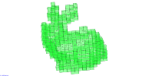
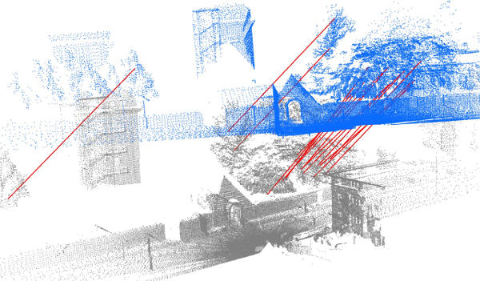
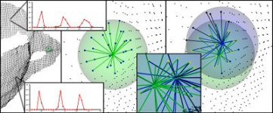
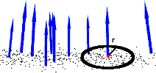
Plugin Tools
Spatial data structures
KD-Tree
Octree
Registration
Iterative Closest Point
Normal Distributions Transform
Point selectors
Rectangle
Lasso
Connected Components
Features
Normals
(F) Point Feature Histograms
SHOT

Slide 16
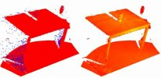
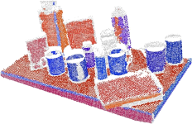
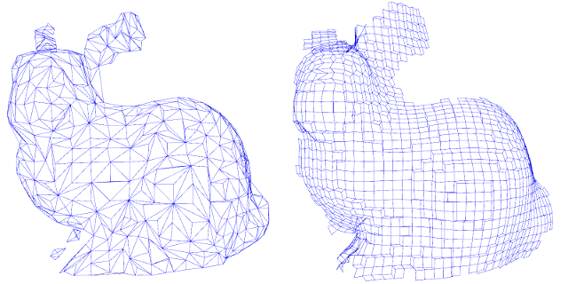
Plugins
Filters
Downsample
Outlier Removal
Segmentation
Euclidean Clusters
Models- Plane/Cylinder/Sphere
Mesh generation/smoothing
Greedy triangulation
MLS smoothing
Concave/Convex Hulls
Marching Cubes

Slide 17
Pointclouds in PowerPoint (P. Kalogiros, G. Popa)
Hard to show a 3D in a single frame
Interact with point clouds live during presentations
Saves tremendous time getting viewpoints correct for screenshots

Slide 18
World Premier!

Slide 19
VTK/PCL Interface
Researchers shouldn’t have to choose one or the other
Easy to start working with PCL if you are used to working with VTK
Handles points, as well as common attributes (normals and colors)
Easily apply PCL algorithms to existing VTK datasets

Slide 20
VTK/PCL Conversions
vtkStructuredGrid -> pcl::PointCloud (organized)
vtkPolyData -> pcl::PointCloud (unorganized)
pcl::PointCloud (organized) -> vtkStructuredGrid
pcl::PointCloud (unorganized) -> vtkPolyData

Slide 21
PCL Examples Initiative
PCL has excellent tutorials
Users like to learn by example
Can’t have a tutorial for every single function
ITK
VTK

Slide 22
Examples Initiative
Modeled after successful VTK/ITK examples
Store examples directly in main repository
Give anyone who asks commit access to the examples/ directory

Slide 23
Homework
Go home, install PCL
Start learning PCL
When you have your first question, solve it (perhaps ask the mailing list)
Turn it into an example and send it to the mailing list

Slide 24
Summary
Many exciting new additions
Thanks Google Summer of Code!
Please contribute!

